Slide 1



DIRECT-TO-EMPLOYER PLAN
September 24, 2024

Slide 2



Founded in 1979 and headquartered in Indianapolis, IN​
Full-service TPA specializing in the administration of self-funded health plans and population health management​
One of the country’s largest independently-owned TPAs
The Key Family is a commonly-held group of benefits related organizations with:​
3,000+ corporate clients​
3.0 million members under management​
700 Employees
Exclusive Relationships
We know The Market – Agents, Networks, and MGAs

Slide 3


Healthcare Leader in Private Labeled DTE Plans
Louisville, KY
OneHealth Plan
Cincinnati, OH
TCH Optimal
Bentonville, AR
Northwest Health Plan
Knoxville, TN
East Tennessee Health Plan
Meridian, MS
Affinity Health Plan
Fort Myers, FL
Lee Health Care Partners

Slide 4

Direct-to-Employer Strategy: Only Available to Premier Health Systems
STRONG Brand Quality
EXTENSIVE Patient Access
AFFORDABLE Value Pricing
EXCELENT Care Quality

Slide 5
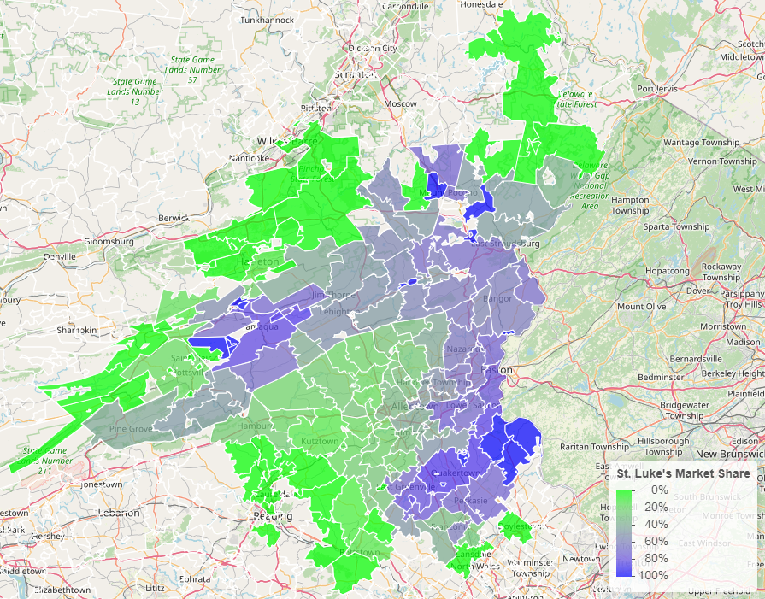

SLUHN Advantage: Strong Brand Quality
Comparison of Medicare payment market share by zip code: St Luke’s vs Lehigh Valley Health Network

Slide 6
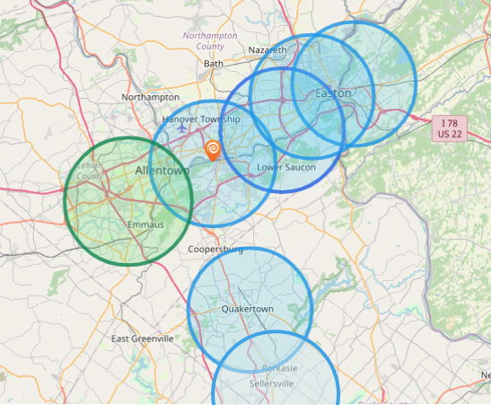
SLUHN Advantage: Best-in-Area Patient Access
Hospital | Population Within 5 Miles
St Luke's Hospital - Anderson Campus | 142,000
St Lukes Upper Bucks Campus | 46,000
St Luke's Hospital Bethlehem | 255,000
St Luke's Warren Hospital | 118,000
St Luke's Hospital - Easton Campus | 141,000
St. Luke’s Hospital Monroe County | 48,667
St. Luke’s Hospital Carbon County | 26,628
Grand View Hospital | 70,739
Hospital | Population Within 5 Miles
Lehigh Valley Hospital Cedar Crest | 227,393

Slide 7

SLUHN Advantage: Leading Care Quality
Patient HCAHPS Recommendation Rate Percentile | CMS Quality Stars Percentile | Mortality Average Percentile | Readmission Percentile
73% | 99% | 86% | 63%
53% | 58% | 72% | 63%
Source: CMS measurements of HCAHPS patient experience (percent who would strongly recommend), CMS Stars, high-variation mortality rates and high-variation readmission rates all shown as percentiles compared to all hospitals nationally, with the 99th percentile being the best.

Slide 8
SLUHN Advantage: Care at Value Pricing
Hospital | Rand Outpatient Services Percent of Medicare | Rand Inpatient Services Percent of Medicare
St Luke's Hospital - Anderson Campus | 290% | 280%
St Lukes Upper Bucks Campus | 292%
St Luke's Hospital Bethlehem | 287% | 214%
St Luke's Warren Hospital | 251%
St Luke's Hospital - Easton Campus | 212%
St Luke’s Hospital - Monroe County | 251% | 219%
Grand View Hospital | 179% | 197%
Lehigh Valley Hospital Cedar Crest | 315% | 249%
Source: RAND round 5 hospital cost data: https://www.rand.org/pubs/research_reports/RRA1144-2.html

Slide 9

Direct-to-Employer (DTE) Your plan focused on Your relationship with Employers
YOU Pick the Name of the Health Plan
YOU Determine the Fees Charged
YOU Practice the Medicine
YOU Receive the Profits
WE Make it Successful

Slide 10

Every $1 of Care
Government Pay
Commercial Pay
Results in
~$.47 of loss
Generates
~$.37 of profit
See Slide 35 for More Details on Calculation of Commercial and Government-Pay Net Income

Slide 11


Direct-to-Employer Strategy: Increased Capture of Commercial Market Share
SLUHN DTE
PPO #1
PPO #2
PPO #3

Slide 12

Direct-to-Employer Strategy: Powerful Employer Value
Reduced medical spend through care control
“At the table” with SLUHN
Incentivized medical partners
Improved and “superior” analytics
Competitive stop-loss
Increased flexibility
Increased cash flow & stabilization of cost

Slide 13
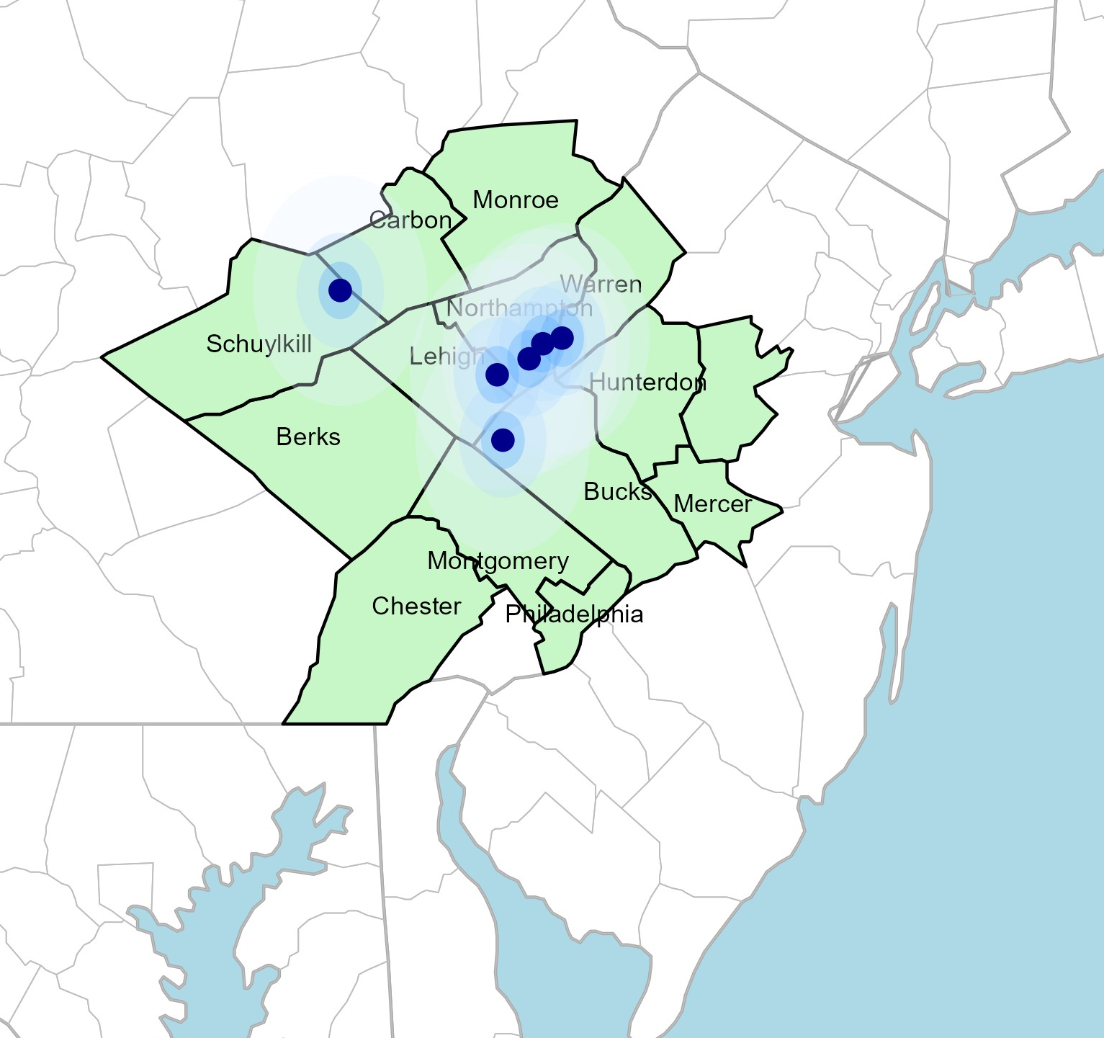
Significant Opportunity for SLUHN
Target Market 2,353 Employers 390,000+ Employees 627,000+ Members
 | Total Employees
Commercial Employers With Headquarters: | 50-100 | 101-200 | 201-400 | 401-1000 | 1001-3000 | 3000+
Within 10 Miles of SLUHN Hospital | 552 | 261 | 161 | 73 | 13 | 15
Within 11-20 Miles of SLUHN Hospital | 767 | 278 | 175 | 86 | 24 | 10
Within 21-30 Miles of SLUHN Hospital | 1908 | 775 | 544 | 290 | 105 | 75
Employees at Above Firms | 50-100 | 101-200 | 201-400 | 401-1000 | 1001-3000 | 3000+
Within 10 Miles of SLUHN Hospital | 41,400 | 39,150 | 48,300 | 51,100 | 26,000 | 165,000
Within 11-20 Miles of SLUHN Hospital | 57,525 | 41,700 | 52,500 | 60,200 | 48,000 | 110,000
Within 21-30 Miles of SLUHN Hospital | 143,100 | 116,250 | 163,200 | 203,000 | 210,000 | 825,000
Total Members at Firms | 50-100 | 101-200 | 201-400 | 401-1000 | 1001-3000 | 3000+
Within 10 Miles of SLUHN Hospital | 66240 | 62640 | 77,280 | 81,760 | 41,600 | 264,000
Within 11-20 Miles of SLUHN Hospital | 92040 | 66720 | 84,000 | 96,320 | 76,800 | 176,000
Within 21-30 Miles of SLUHN Hospital | 228960 | 186000 | 261,120 | 324,800 | 336,000 | 1,320,000

Slide 14
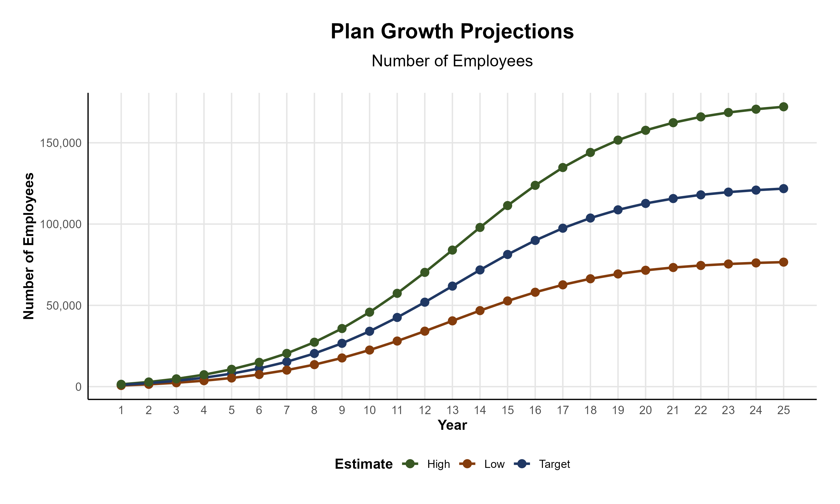
Plan Potential Growth Paths
Self Funded
538K
PLAN GROWTH POTENTIAL
935K
Insured
Working Age
1,230K
Population
2,106K
Estimates include Hunterdon, Warren, Bucks, Carbon, Lehigh, Luzerne, Northampton, and Schuylkill Counties

Slide 15

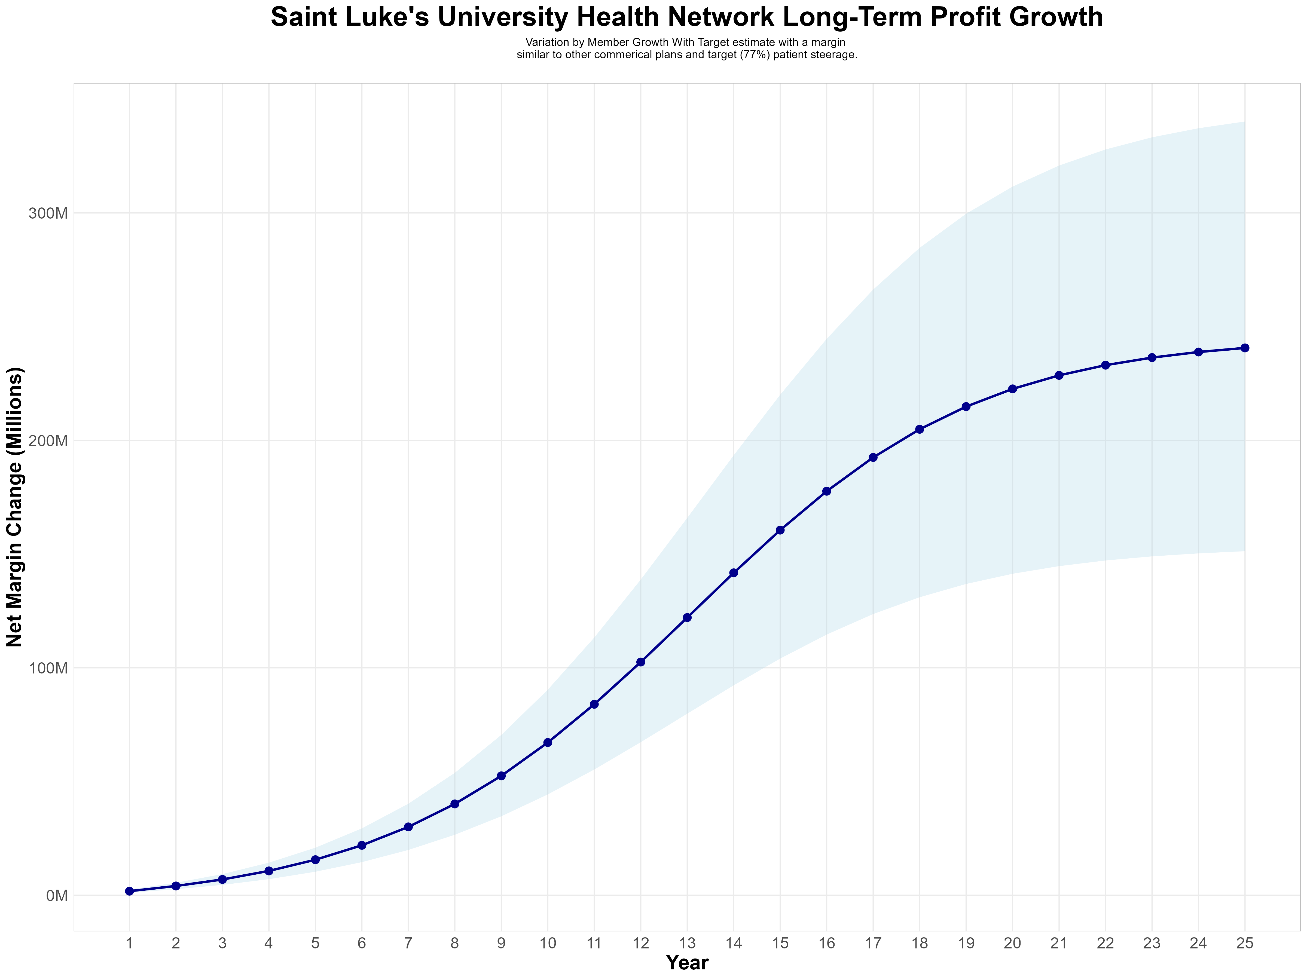
Growing Powerful, Lasting Profitability
Early Stage
Graining Name Recognition, Early Growth
New Revenue:
New Profit:
$63.33M
$16.41M
Growth Stage
Strong Reputation, Strong Growth
New Revenue:
New Profit:
$433.64M
$113.52M
Mature Stage
High Profitability, Market Saturation
New Revenue:
New Profit:
$853.45M
$223.6M

Slide 16
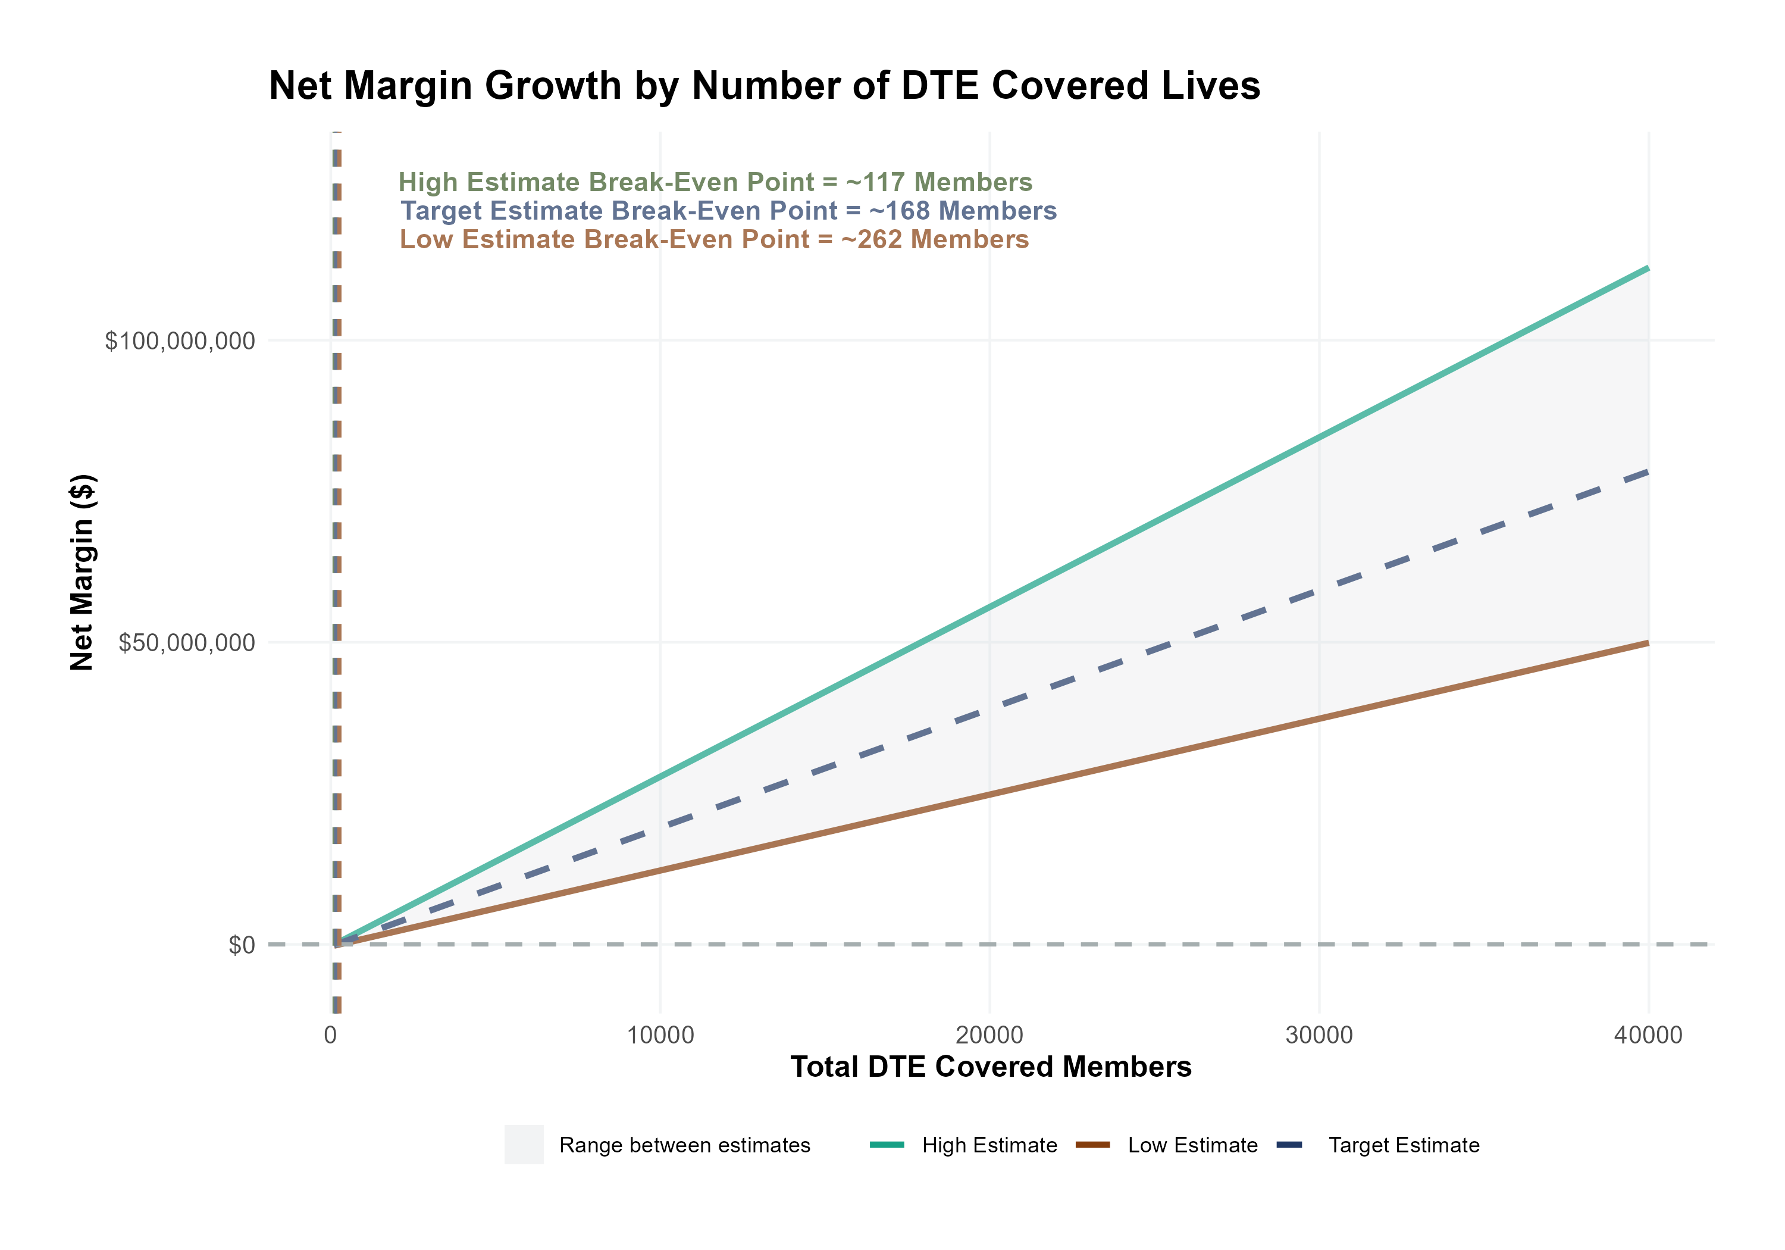
Estimated Financial Returns and Assumptions
Patient Steerage Assumptions
KBA currently estimates that Saint Luke's University Health Network has 34% inpatient market share, and 17% outpatient market compared to hospitals/clinics in the Luzerne, Carbon, Schuylkill, Lehigh, Northampton, Warren, Hunterdon, and Bucks Counties. Based on other KBA DTE networks, we expect steerage to be:
SINGLE-YEAR PROJECTION
Low
Target
High
70%
77%
85%
Commercial Margin Assumptions
KBA estimates DTE margins to be similar to the margin of other commercial plans (prices are lower but billing costs and self-payments are higher). We model DTE commercial margin as on target, below and above other commercial plans.
Low
Target
High
5% Below
Same
5% Above

Slide 17
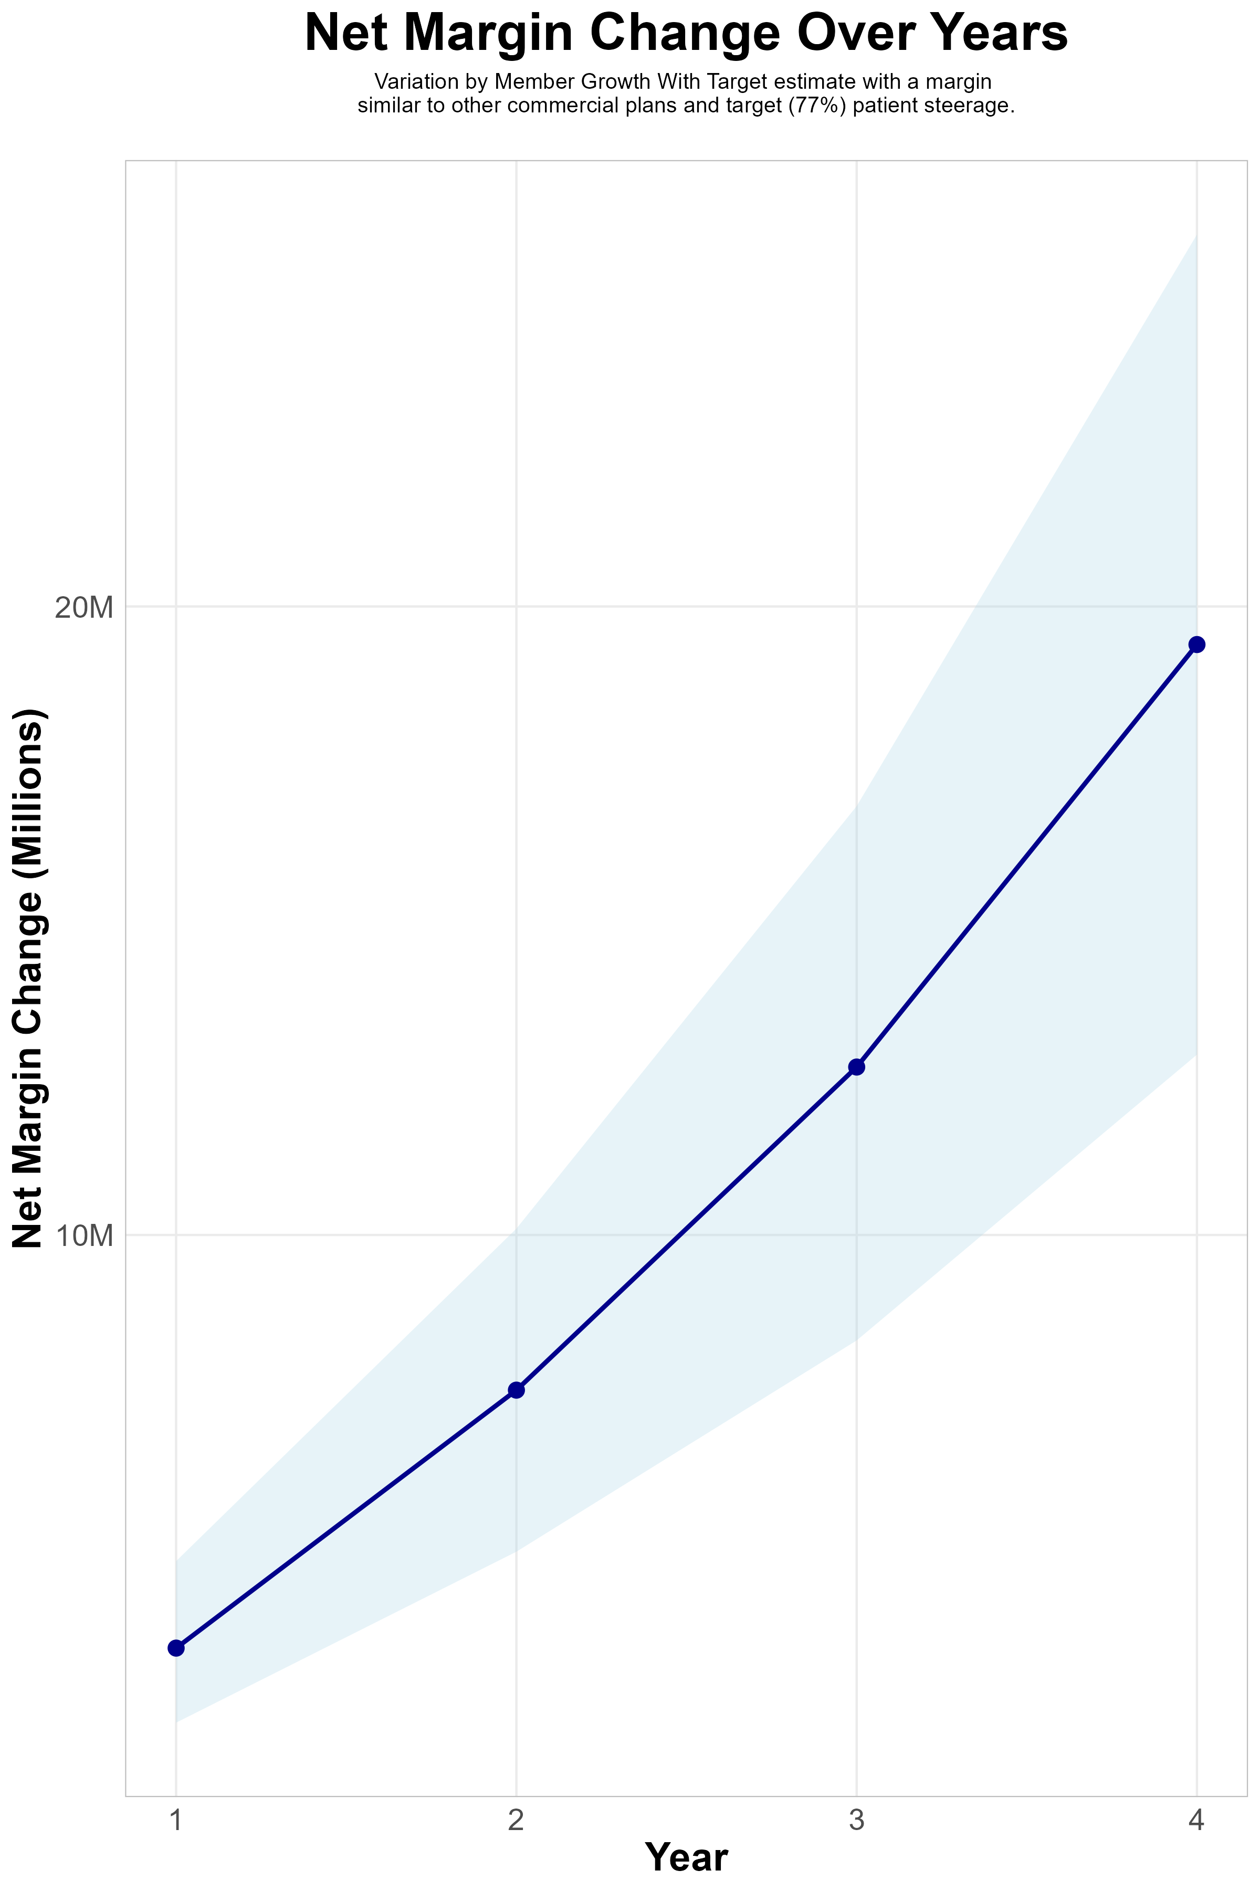
FOUR-YEAR PROJECTIONS
Target Member Growth | Target Member Growth | Target Member Growth | Target Member Growth | Target Member Growth
Metric | Year 1 | Year 2 | Year 3 | Year 4
Number of Members | 1,900 | 3,900 | 6,500 | 9,900
Incremental Margin | 3,733.8K | 7,664.2K | 12,773.7K | 19,455.3K
Network Access Fee | 22.8K | 46.8K | 78.0K | 118.8K
Implementation Fee (One-Time) | -150.0K | 0.0K | 0.0K | 0.0K
Sales and Marketing Costs | -180.0K | -180.0K | -180.0K | -180.0K
Net Margin Change | 3,426.6K | 7,531.0K | 12,671.7K | 19,394.1K
High Member Growth | High Member Growth | High Member Growth | High Member Growth | High Member Growth
Metric | Year 1 | Year 2 | Year 3 | Year 4
Number of Members | 2,600 | 5,200 | 8,600 | 13,200
Incremental Margin | 5,109.5K | 10,218.9K | 16,900.6K | 25,940.4K
Network Access Fee | 31.2K | 62.4K | 103.2K | 158.4K
Implementation Fee (One-Time) | -150.0K | 0.0K | 0.0K | 0.0K
Sales and Marketing Costs | -180.0K | -180.0K | -180.0K | -180.0K
Net Margin Change | 4,810.7K | 10,101.3K | 16,823.8K | 25,918.8K
Low Member Growth | Low Member Growth | Low Member Growth | Low Member Growth | Low Member Growth
Metric | Year 1 | Year 2 | Year 3 | Year 4
Number of Members | 1,300 | 2,600 | 4,300 | 6,600
Incremental Margin | 2,554.7K | 5,109.5K | 8,450.3K | 12,970.2K
Network Access Fee | 15.6K | 31.2K | 51.6K | 79.2K
Implementation Fee (One-Time) | -150.0K | 0.0K | 0.0K | 0.0K
Sales and Marketing Costs | -180.0K | -180.0K | -180.0K | -180.0K
Net Margin Change | 2,240.3K | 4,960.7K | 8,321.9K | 12,869.4K

Slide 18

SLUHN NETWORK
Out of Network
Friends & Family (Contracted)
Wrap Network (Rented)
SLUHN’s Network
The medical providers in your direct control or part of SLUHN’s integrated delivery system
Potential risk sharing arrangements (e.g. employer stop-loss participation)
Friends & Family Providers – TIER 1
Access through direct contracts at the discretion of SLUHN
WRAP NETWORK
Medical services from national PPO networks for members that travel, tertiary and specialty services you do not provide, and employees residing outside your direct catchment area
OUT-OF-NETWORK
Non-contracted medical providers

Slide 19

BENEFIT PLAN DESIGNS THAT OPTIMIZE STEERAGE TO SLUHN
Exclusive Provider Organization (EPO) Plan Design Structure

Slide 20
SINGLE YEAR SUMMARY
DTE Covered Members Financial Analysis | DTE Covered Members Financial Analysis | DTE Covered Members Financial Analysis | DTE Covered Members Financial Analysis | DTE Covered Members Financial Analysis | DTE Covered Members Financial Analysis | DTE Covered Members Financial Analysis | DTE Covered Members Financial Analysis
Target estimate with a margin similar to other commercial plans and target (77%) patient steerage. | Target estimate with a margin similar to other commerical plans and target (77%) patient steerage.. | Target estimate with a margin similar to other commerical plans and target (77%) patient steerage.. | Target estimate with a margin similar to other commerical plans and target (77%) patient steerage.. | Target estimate with a margin similar to other commerical plans and target (77%) patient steerage.. | Target estimate with a margin similar to other commerical plans and target (77%) patient steerage.. | Target estimate with a margin similar to other commerical plans and target (77%) patient steerage.. | Target estimate with a margin similar to other commerical plans and target (77%) patient steerage..
DTE Members | Pre-DTE Revenue | Pre-DTE Margin | DTE Revenue | DTE Incr. Revenue | DTE Total Margin | DTE Incr. Margin | Net Margin Less DTE Fees
100 | $ 273K | $ 71K | $ 1,027K | $ 754K | $ 266K | $ 195K | $ -133K
500 | $ 1,367K | $ 354K | $ 5,137K | $ 3,770K | $ 1,331K | $ 977K | $ 653K
1,000 | $ 2,734K | $ 708K | $ 10,275K | $ 7,541K | $ 2,661K | $ 1,953K | $ 1,635K
2,500 | $ 6,836K | $ 1,771K | $ 25,687K | $ 18,852K | $ 6,654K | $ 4,883K | $ 4,583K
10,000 | $27,343K | $ 7,082K | $102,749K | $ 75,406K | $26,614K | $19,532K | $19,322K
20,000 | $54,685K | $14,165K | $205,498K | $150,812K | $53,228K | $39,064K | $38,974K
NOTE: Please see detailed financial analysis and assumptions used starting on page 34.
Financial projections do not include 340B contribution margin, which could represent $136 pmpm based upon optimizing 340B through plan design, SLUHN’s approved site(s) with network integration, and development of SLUHN’s proprietary PBM program.

Slide 21

the missing piece to population health success
Patient engagement is the failure point of population health efforts. Direct employer participation is key to driving patient engagement.
Key Benefits DTE strategy positioned SLUHN to dramatically grow commercial market share by lowering per-employee plan costs by 11% to 17% at a time when employers are desperate for a path to better value.
SLUHN can demonstrate greater completion rates for Standards of Care for the Chronically Ill, driving better care outcomes.
Adding SLUHN’s managed care processes will only turbocharge the overall results – Positioning SLUHN as the transformational PA healthcare leader.
SLUHN CAN PROMOTE THESE RESULTS FOR ITS OWN PROGRAM FROM DAY ONE!!

Slide 22

CHRONIC CONDITION | MINIMUM ANNUAL CARE RECOMMENDED
ASTHMA | 2 Clinical Evaluations 1 Spirometry (for patients 10 years of age or older)
ATRIAL FIBRILLATION | 1 Clinical Evaluation
CHRONIC OBSTRUCTIVE PULMONARY DISEASE | 1 Clinical Evaluation 1 Spirometry
CHRONIC VENOUS THROMBOTIC DISEASE previously listed as Thrombo-embolic Disease | 1 Clinical Evaluation
COPD WITH PULMONARY HYPERTENSION/COR PULMONALE | 2 Clinical Evaluations 12 months of supplemental 02 Tx
CHRONIC KIDNEY DISEASE | 1 Clinical Evaluation 1 Hgb or Hcrt | 1 Serum Creatinine 1 Serum Potassium | 1 Serum Calcium 1 Serum Phosphorus
CONGESTIVE HEART FAILURE | 1 Clinical Evaluation | 1 Serum Creatinine | 1 Serum Potassium
CORONARY ARTERY DISEASE | 1 Clinical Evaluation | 1 LDL
DEPRESSION | 1 Clinical Evaluation
DIABETES | 2 Clinical Evaluations 2 Glycohemoglobins 1 Serum Creatinine | 1 Lipid Panel IF no nephropathy Dx or ACE/ARB Rx, 1 Urine Albumin/Creatinine ratio, Total Protein
EPILEPSY | 1 Clinical Evaluation
HUMAN IMMUNODEFICIENCY VIRUS INFECTION | 2 Clinical Evaluations 2CBCs I T-Cell/CD-4 Count | 2 HIV Quantifications 1 Pap Smear (for women only, 21 years of age or older)
Hyperlipidemia | 1 Lipid Panel
HYPERTENSION | 1 Clinical Evaluation | 1 Serum Creatinine
HYPERTHYROIDISM | 1 Clinical Evaluation | 1 TSH | 1 T4
HYPOTHYROIDISM | 1 Clinical Evaluation | 1 TSH
METABOLIC SYNDROME | 1 Clinical Evaluation | 1 Lipid Panel | 1 FBS or HgbA1c
MULTIPLE SCLEROSIS | 1 Clinical Evaluation
PARKINSON'S DISEASE | 1 Clinical Evaluation
PERIPHERAL ARTERIAL DISEASE (ATHEROSCLEROSIS] previously listed as Peripheral Vascular Disease | 1 Clinical Evaluation 1 LDL
PRE-DIABETES | 1 Clinical Evaluation | 1 Lipid Panel | 1 FBS or HgbA1c
POLYMYALGIA RHEUMATICA | 2 Clinical Evaluation | 2 ESR or CRP | 1 CBC
PULMONARY HYPERTENSION (UNRELATED TO COPD) | 2 Clinical Evaluation
REGIONAL ENTERITIS (INFLAMMATORY BOWEL DISEASE) | 1 Clinical Evaluation
RHEUMATOID ARTHRITIS | 1 Clinical Evaluation
SLEEP APNEA | 1 Clinical Evaluation
ULCERATIVE COLITIS (INFLAMMATORY BOWEL DISEASE) | 1 Clinical Evaluation
INTEGRATION TO SLUHN EPIC SYSTEM
CHRONIC DISEASE MANAGEMENT
The chronic diseases identified include a list of services (i.e. exams, lab work and diagnostics) rendered by a network provider payable at 100% and not subject to the deductible or copay.
KBA shares evidence-based standards of care for 27 chronic conditions directly into the Epic medical system.

Slide 23

Transparent PBM Integration
Support of SLUHN’s retail pharmacy(s)
Optimize SLUHN’s 340B drug pricing program
Allows SLUHN to create its own PBM program if desired
Custom telephone number with personalized scripting and separate call tracking & reporting
Fully customizable member welcome booklet & materials
White labeled formulary document and marketing materials
CUSTOM CLIENT SUPPORT:
Specialized call center capabilities
Fully customizable plan designs
Operational access to the platform
Customized process and functions to promote DTE strategy
CLINICAL FLEXIBILITY:
Full portfolio of custom formulary offerings – with optimized formulary shield
Clinical programs that drive towards overall DTE strategy
Options for additional drug savings by driving members to lower cost alternatives
Flexibility to customize or layer on utilization management programs

Slide 24
STOP-LOSS INSURANCE
Tokio Marine
Nationwide
Berkshire Hathaway
Sun Life
Liberty Mutual
Granular (Google)
Companion Life
Crum & Forster
American Fidelity
RGA
KBA has over 20 stop-loss underwriters and carriers that we work with on core employer sponsored plans and DTE health plans;
KBA performs a comprehensive analysis of each stop-loss partner to approve them for our business;
KBA provides comprehensive pricing and medical service analysis for each DTE health plan to ensure proper pricing;
KBA is also evaluated by the stop-loss markets to be an approved claims payer for them;
KBA provides the administration required of the stop-loss markets:
Bordereau Reporting;
Claim Reporting and Reconciliation;
Evaluation of Networks;
Care Management;
Initial Underwriting;
Negotiation of rates and terms; and
Plan Design Actuarial

Slide 25

DTE PROGRAM MARKETING & SALES
KBA WORKS WITH YOU TO MANAGE & SELL:
Branding & Messaging
Direct & Brokerage Sales Distribution – Focused Sales Representative
Brochures, Web Site, Media, etc.
Stop-Loss/Level Funded Down to 20 EE Lives
Sell Through Established Brokers in Your Service Area

Slide 26

Complete Sales Distribution System
BROKER DEVELOPMENT
Identification of Key Distribution Agents
Training and Development
DIRECT SALES
Identification of Key Targets
Working with SLUHN on Specific Employers
SALES ADMINISTRATION
Quote System
Quote Evaluation
Compensation
Meet and Greet
Sales Process
Closing
Stop Loss Negotiations
Reporting & Analysis
Proposal Development

Slide 27
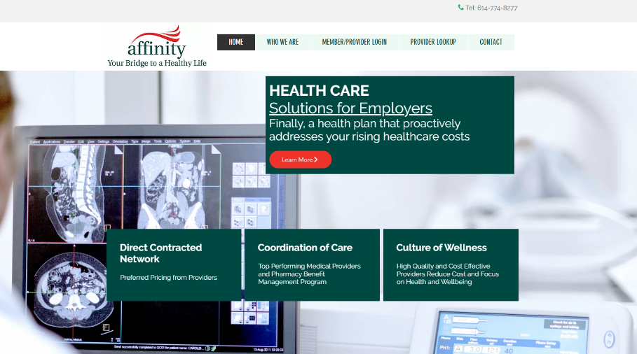








Complete Marketing System
Customized Branding and Messaging
Customized Brochures
Customized Web Site
Targeted Employer Outreach
Sales System (Social Media, Email, Text, etc.)

Slide 28
Modeling for Community-Based Plan
Plan modeled at far lower patient steerage rates but above current market share. Patient steerage can be achieved through pay card and virtual primary care.

Slide 29

Far Lower Profitability Growth
Early Stage
Graining Name Recognition, Early Growth
New Revenue:
New Profit:
$14.47M
$3.75M
Growth Stage
Strong Reputation, Strong Growth
New Revenue:
New Profit:
$99.06M
$26.86M
Mature Stage
High Profitability, Market Saturation
New Revenue:
New Profit:
$194.97M
$53.04M

Slide 30
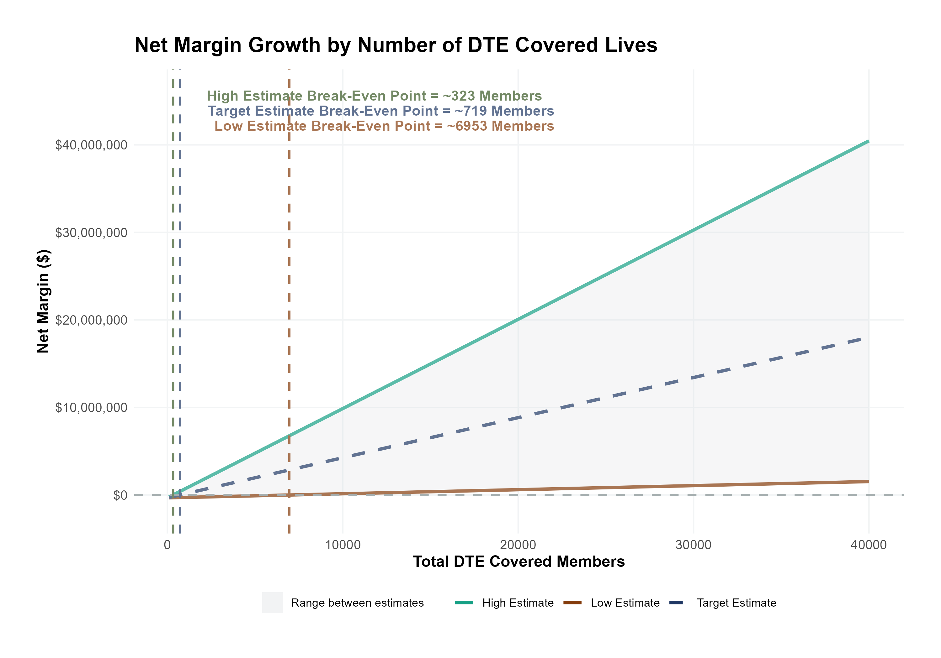
Estimated Financial Returns and Assumptions
Patient Steerage Assumptions
KBA currently estimates that Saint Luke's University Health Network has 32% inpatient market share, and 18% outpatient market compared to hospitals/clinics in the Luzerne, Carbon, Schuylkill, Lehigh, Northampton, Warren, Hunterdon, and Bucks. Within a community network, we would assume market share to be:
SINGLE-YEAR PROJECTION
Low
Target
High
37%/25%
42%/32%
50%/40%
Commercial Margin Assumptions
KBA estimates DTE margins to be similar to the margin of other commercial plans (prices are lower but billing costs and self-payments are higher). We model DTE commercial margin as on target, below and above other commercial plans.
Low
Target
High
5% Below
Same
5% Above

Slide 31
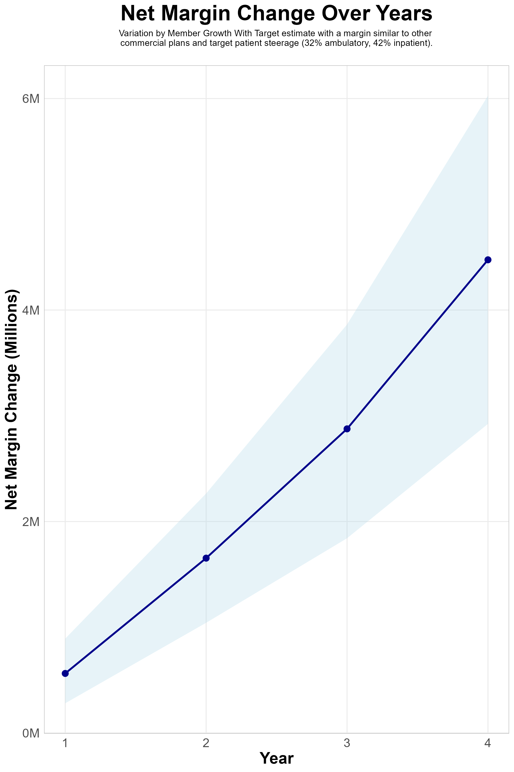
FOUR-YEAR PROJECTIONS
Target Member Growth | Target Member Growth | Target Member Growth | Target Member Growth | Target Member Growth
Metric | Year 1 | Year 2 | Year 3 | Year 4
Number of Members | 1,900 | 3,900 | 6,500 | 9,900
Incremental Margin | 870.6K | 1,786.9K | 2,978.2K | 4,536.1K
Network Access Fee | 22.8K | 46.8K | 78.0K | 118.8K
Implementation Fee (One-Time) | -150.0K | 0.0K | 0.0K | 0.0K
Sales and Marketing Costs | -180.0K | -180.0K | -180.0K | -180.0K
Net Margin Change | 563.4K | 1,653.7K | 2,876.2K | 4,474.9K
High Member Growth | High Member Growth | High Member Growth | High Member Growth | High Member Growth
Metric | Year 1 | Year 2 | Year 3 | Year 4
Number of Members | 2,600 | 5,200 | 8,600 | 13,200
Incremental Margin | 1,191.3K | 2,382.6K | 3,940.4K | 6,048.1K
Network Access Fee | 31.2K | 62.4K | 103.2K | 158.4K
Implementation Fee (One-Time) | -150.0K | 0.0K | 0.0K | 0.0K
Sales and Marketing Costs | -180.0K | -180.0K | -180.0K | -180.0K
Net Margin Change | 892.5K | 2,265.0K | 3,863.6K | 6,026.5K
Low Member Growth | Low Member Growth | Low Member Growth | Low Member Growth | Low Member Growth
Metric | Year 1 | Year 2 | Year 3 | Year 4
Number of Members | 1,300 | 2,600 | 4,300 | 6,600
Incremental Margin | 595.6K | 1,191.3K | 1,970.2K | 3,024.1K
Network Access Fee | 15.6K | 31.2K | 51.6K | 79.2K
Implementation Fee (One-Time) | -150.0K | 0.0K | 0.0K | 0.0K
Sales and Marketing Costs | -180.0K | -180.0K | -180.0K | -180.0K
Net Margin Change | 281.2K | 1,042.5K | 1,841.8K | 2,923.3K

Slide 32
SINGLE YEAR SUMMARY
DTE Covered Members Financial Analysis | DTE Covered Members Financial Analysis | DTE Covered Members Financial Analysis | DTE Covered Members Financial Analysis | DTE Covered Members Financial Analysis | DTE Covered Members Financial Analysis | DTE Covered Members Financial Analysis | DTE Covered Members Financial Analysis
Target estimate with a margin similar to other commercial plans and target patient steerage (32% ambulatory, 42% inpatient).. | Target estimate with a margin similar to other commercial plans and target patient steerage (32% ambulatory, 42% inpatient).. | Target estimate with a margin similar to other commercial plans and target patient steerage (32% ambulatory, 42% inpatient).. | Target estimate with a margin similar to other commercial plans and target patient steerage (32% ambulatory, 42% inpatient).. | Target estimate with a margin similar to other commercial plans and target patient steerage (32% ambulatory, 42% inpatient).. | Target estimate with a margin similar to other commercial plans and target patient steerage (32% ambulatory, 42% inpatient).. | Target estimate with a margin similar to other commercial plans and target patient steerage (32% ambulatory, 42% inpatient).. | Target estimate with a margin similar to other commercial plans and target patient steerage (32% ambulatory, 42% inpatient)..
DTE Members | Pre-DTE Revenue | Pre-DTE Margin | DTE Revenue | DTE Incr. Revenue | DTE Total Margin | DTE Incr. Margin | Net Margin Less DTE Fees
100 | $ 291K | $ 75K | $ 463K | $ 172K | $ 120K | $ 45K | $ -284K
500 | $ 1,456K | $ 377K | $ 2,317K | $ 861K | $ 600K | $ 223K | $ -101K
1,000 | $ 2,911K | $ 754K | $ 4,634K | $ 1,723K | $ 1,200K | $ 446K | $ 128K
2,500 | $ 7,278K | $ 1,885K | $11,585K | $ 4,306K | $ 3,001K | $1,115K | $ 815K
10,000 | $29,114K | $ 7,541K | $46,340K | $17,226K | $12,003K | $4,462K | $4,252K
20,000 | $58,228K | $15,082K | $92,680K | $34,452K | $24,006K | $8,924K | $8,834K
NOTE: Please see detailed financial analysis and assumptions used starting on page 23.
Financial projections do not include 340B contribution margin, which could represent $136 PMPM by optimizing 340B through Rx plan design, SLUHN’s approved site(s) with network integration, and development of SLUHN’s proprietary PBM program.

Slide 33
Pre-DTE Cohort of 5,000 Members | Inpatient | Outpatient | Professional | Total
Revenue† | $ 5,822,400 | $ 5,954,400 | $ 2,780,100 | $ 14,556,900
Net Income‡ | $ 1,508,128 | $ 1,542,319 | $ 720,106.3 | $ 3,770,553
† Assuming proportional revenues from market shares of 32% (inpatient) and 18% (outpatient)
‡ Conservatively assuming a commercial margin of 25.9% (70% of the estimated commercial margin)
With DTE | Inpatient | Outpatient | Professional | Total
Revenue⁰ | $ 7,641,900 | $ 10,585,600 | $ 4,942,400 | $ 23,169,900
Net Income* | $ 1,979,418 | $ 2,741,900 | $ 1,280,189 | $ 6,001,507
⁰ Assuming 42% market steerage based on KBA narrow network DTE experience
* Conservatively assuming a commercial margin of 25.9%, with a 10 percentage-point reduction to reflect competitive-edge rates and a 10 percentage-point increase to reflect lower billing costs and better patient-responsibility collections because of the plan patient card.
Total Increase in Net Income | $ 2,230,954
Network Access Fee (Revenue) of $1 PMPM | $ 60,000
Total Profit Growth | $ 2,290,954
Minus Implementation Fee (One-Time) | -$ 150,000
Minus Sales and Marketing (Annual – Ongoing) | -$ 180,000
Total | $ 1,960,954

Slide 34


FINANCIAL PROJECTIONS & ASSUMPTIONS

Slide 35
Estimation of SLUHN’s 2021 Payer Mix
Payer Group | Total Inpatient Days | Revenue | Payer Mix
All SLUHN | 316,301 | $2,393,180K | 100%
Medicare | 103,307 | $475,586K | 32%
Medicaid | 19,760 | $225,955K | 6%
Other Government Pay | 0
No-Pay, Charity Care | 12,842 | ($102,024K) | 4%
Commercial/Self Pay | 180,392 | $1,693,393K | 57%
Estimating Payer Mix
Medicare, Medicaid, and other government payer mixes are estimated as the percentage of inpatient days for each group divided by total inpatient days.
No-pay and charity care is estimated as the percentage of no-pay/charity care compared to total overall revenue.
Commercial/self pay is assumed to be the rest of the total payer mix share.
Estimating Total Inpatient Days
Total inpatient days for ‘No Pay’ and ‘Commercial’ are estimated to be the payer mix estimates for “No Pay, Charity Care” and “Commercial/Self Pay” multiplied by the total number of inpatient days.
Values in blue are taken from the 2021 Medicare Provider Cost Report (https://data.cms.gov/provider-compliance/cost-report/hospital-provider-cost-report/data)
Values in yellow are taken from Definitive Healthcare data.
In other analysis, the outpatient payer mix is assumed to mirror the inpatient payer mix.

Slide 36
Estimation of Margin for Commercial vs. Government Pay
The RAND data for SLUHN estimates commercial insurance reimbursements at 233% of Medicare Rates
Estimating Commercial Margin
(Calculated through counterfactual of assuming all CMS/Government pay was paying at commercial rates)
Estimating Gov-Pay Margin
(Calculated through counterfactual of assuming all commercial pay was paying at Medicare rate)
Commercial Revenue | $1,693,393K
Gov-pay revenue at 233% current rate | $1,631,785K
Total Revenue | $3,325,178K
Total Costs | $2,095,506K
Net Income | $1,229,671K
 | 37%
Commercial Revenue Divided by 233% | $728,028K
Gov-pay revenue | $701,541K
Total Revenue | $1,429,569K
Total Costs | $2,095,506K
Net Income | $ -665,937K
 | -47%

Slide 37
Modeling Prices and Commercial Margins
KBA recommends targeting KBA DTE prices 10% below commercial rates (resulting in a roughly 10 percentage-point drop in DTE profit).
To compensate for this lower margin, KBA provides the following margin improvements:
Streamlined billing ensures no pre-authorization far friendlier billing practices than commercial insurance.
Patient cards allow patients a no-interest payment option for SLUHN patient-responsibility payments. This card also improves patient steerage towards SLUHN.

Slide 38
Estimating Market Share
Hospital Name | Number of Beds | Inpatient Total Charges | Outpatient Total Charges | Inpatient Percent of Market Total | Outpatient Percent of Market Total (Assuming 56.1% of Physicians Employed by Hospitals)
St Luke's Warren Hospital | 92 | $ 464,369.1K | $1,008,837.0K | 2% | 2%
St. Luke's Upper Bucks Campus | 86 | $ 522,787.0K | $ 748,428.8K | 2% | 1%
St Luke's Hospital Bethlehem | 783 | $4,431,459.5K | $4,512,769.9K | 20% | 8%
Grand View Hospital | 180 | $ 313,554.5K | $ 459,480.3K | 2% | 1%
St Luke's Hospital - Easton Campus | 29 | $ 113,367.3K | $ 317,923.5K | 1% | 1%
St Luke's Miners Memorial Hospital | 49 | $ 149,719.5K | $ 428,768.3K | 1% | 1%
St Luke's Hospital - Anderson Campus | 193 | $1,295,917.8K | $1,620,203.3K | 6% | 3%
OSF Holy Family Medical Center | 15 | $ 7,959.6K | $ 107,751.2K | 0% | 0%
Ascension St Vincent Williamsport (FKA St Vincent Williamsport Hospital) | 16 | $ 10,559.8K | $ 84,780.5K | 0% | 0%
The Medical Center at Bowling Green | 318 | $ 803,256.9K | $ 666,736.1K | 4% | 1%
TriStar Greenview Regional Hospital | 118 | $ 428,341.9K | $ 641,858.8K | 2% | 1%
Merit Health River Region (FKA River Region Health System) | 155 | $ 648,085.0K | $ 492,123.8K | 3% | 1%
Beartooth Billings Clinic | 10 | $ 6,596.1K | $ 24,644.3K | 0% | 0%
Hunterdon Health (FKA Hunterdon Medical Center) | 184 | $ 393,935.6K | $ 929,836.7K | 2% | 2%
Hackettstown Medical Center | 95 | $ 419,072.8K | $ 451,745.3K | 2% | 1%
Glens Falls Hospital | 391 | $ 378,756.5K | $ 714,562.5K | 2% | 1%
Atrium Medical Center | 244 | $ 563,010.9K | $ 556,450.0K | 2% | 1%
Lehigh Valley Hospital - Schuylkill S Jackson Street | 118 | $ 244,006.4K | $ 346,134.4K | 1% | 1%
Lehigh Valley Hospital - Schuylkill E Norwegian Street | 99 | $ 117,895.3K | $ 181,742.1K | 1% | 0%
Lower Bucks Hospital | 105 | $ 216,227.2K | $ 126,832.8K | 1% | 0%
Lehigh Valley Hospital - Cedar Crest | 1,190 | $6,447,851.8K | $8,433,644.8K | 28% | 15%
Wilkes-Barre General Hospital | 188 | $ 764,343.4K | $1,091,258.7K | 3% | 2%
Warren General Hospital | 85 | $ 63,831.1K | $ 207,521.0K | 0% | 0%
Lehigh Valley Hospital - Hazleton | 134 | $ 263,046.6K | $ 605,706.7K | 1% | 1%
St Lukes Lehighton Campus | 68 | $ 193,471.3K | $ 288,155.6K | 1% | 1%
Doylestown Hospital (AKA Doylestown Health) | 217 | $ 593,232.7K | $ 853,288.6K | 3% | 2%
Geisinger Wyoming Valley Medical Center | 583 | $2,190,243.6K | $4,045,390.9K | 10% | 7%
Rothman Orthopaedic Specialty Hospital | 24 | $ 63,808.3K | $ 209,522.8K | 0% | 0%
Geisinger St Lukes Hospital | 60 | $ 184,744.4K | $ 275,367.2K | 1% | 0%
St Lukes Carbon Campus | 52 | $ 307,695.2K | $ 371,559.4K | 1% | 1%
Ascension Saint Thomas River Park (FKA River Park Hospital) | 56 | $ 97,845.5K | $ 245,030.4K | 0% | 0%
Castleview Hospital | 39 | $ 63,429.8K | $ 221,776.7K | 0% | 0%
Warren Memorial Hospital | 36 | $ 46,268.2K | $ 194,670.3K | 0% | 0%
Memorial Hospital of Carbon County | 25 | $ 9,924.9K | $ 50,036.4K | 0% | 0%
For outpatient market share, it is estimated that only 56.1% of local physicians are employed by area hospitals (Research from the Physician Advocacy Institute: https://www.physiciansadvocacyinstitute.org/Portals/0/assets/docs/PAI-Research/PAI-Avalere%20Physician%20Employment%20Trends%20Study%202019-2023%20Final.pdf?ver=uGHF46u1GSeZgYXMKFyYvw%3d%3d)

Slide 39
Hospital Metrics | Hospital Metrics | Hospital Metrics | Hospital Metrics | Hospital Metrics | Hospital Metrics | Hospital Metrics | Hospital Metrics
Metric | St Luke's Hospital Bethlehem | St Luke's Hospital - Anderson Campus | St. Luke's Upper Bucks Campus | St Luke's Miners Memorial Hospital | St Luke's Warren Hospital | St Luke's Hospital - Easton Campus | Grand View Hospital
Total Hospital Days | 175,348 | 50,266 | 22,200 | 10,032 | 19,488 | 4,553 | 34,414
Total Medicare Days | 52,829 | 15,729 | 6,831 | 4,324 | 8,271 | 1,739 | 13,584
Total Medicaid Days | 11,581 | 4,726 | 1,513 | 210 | 653 | 139 | 938
Total Other Government Payer Days | 0 | 0 | 0 | 0 | 0 | 0 | 0
Total Inpatient Patient Revenue | $602,108.1K | $191,795.8K | $60,120.5K | $27,847.82K | $63,154.19K | $14,624.38K | $95,947.68K
Total Outpatient Patient Revenue | $613,155.9K | $239,790.1K | $86,069.32K | $79,750.91K | $137,201.8K | $41,012.13K | $140,601K
Total Medicare Revenue | $239,589.9K | $94,531.81K | $34,117.06K | $16,775.95K | $40,371.26K | $8,186.026K | $42,014.48K
Estimated Medicaid and Other Government-Pay Revenue | $136,616.8K | $33,310.48K | $10,636.72K | $12,644.13K | $19,332.77K | $4,531.892K | $8,881.773K
Estimated Commercial Revenue | $839,057.3K | $305,159.9K | $101,702.4K | $78,292.09K | $141,070.3K | $42,705.19K | $185,405.8K
Total Uncompensated Care | $48,987.31K | $14,933.32K | $7,920.645K | $6,751.937K | $3,875.871K | $6,692.891K | $12,862.06K
Estimated Inpatient Costs | $507,803.4K | $152,854.5K | $57,209.3K | $24,434K | $45,493.67K | $13,401.86K | $120,788.3K
Estimated Outpatient Costs | $517,120.8K | $191,104.2K | $81,901.61K | $69,974.36K | $98,834.53K | $37,583.72K | $177,002.2K
Total Operating Expenses | $1,024,924K | $343,958.6K | $139,110.9K | $94,408.36K | $144,328.2K | $50,985.57K | $297,790.4K
Net Income | $190,339.8K | $89,043.57K | $7,345.306K | $13,303.81K | $56,446.17K | $4,437.54K | $-61,488.33K
Estimated Payer Mix Percent Medicare | 30.1% | 31.3% | 30.8% | 43.1% | 42.4% | 38.2% | 39.5%
Estimated Payer Mix Percent Medicaid | 6.6% | 9.4% | 6.8% | 2.1% | 3.4% | 3.1% | 2.7%
Estimated Payer Mix Percent Other Government-Pay | 0.0% | 0.0% | 0.0% | 0.0% | 0.0% | 0.0% | 0.0%
Payer Mix Percent No Pay | 3.9% | 3.3% | 5.1% | 5.9% | 1.9% | 10.7% | 5.2%
Estimated Payer Mix Percent Commercial | 59.4% | 56.0% | 57.3% | 48.9% | 52.3% | 48.0% | 52.6%
Estimated Commercial Profit Margin | 40.2% | 42.9% | 32.4% | 35.7% | 48.4% | 29.5% | 2.0%
1. Most data is taken from the CMS provider cost report | 1. Most data is taken from the CMS provider cost report | 1. Most data is taken from the CMS provider cost report | 1. Most data is taken from the CMS provider cost report | 1. Most data is taken from the CMS provider cost report | 1. Most data is taken from the CMS provider cost report | 1. Most data is taken from the CMS provider cost report | 1. Most data is taken from the CMS provider cost report
2. Medicare costs are taken from the Medicare Provider Analysis and Review (MedPAR) | 2. Medicare costs are taken from the Medicare Provider Analysis and Review (MedPAR) | 2. Medicare costs are taken from the Medicare Provider Analysis and Review (MedPAR) | 2. Medicare costs are taken from the Medicare Provider Analysis and Review (MedPAR) | 2. Medicare costs are taken from the Medicare Provider Analysis and Review (MedPAR) | 2. Medicare costs are taken from the Medicare Provider Analysis and Review (MedPAR) | 2. Medicare costs are taken from the Medicare Provider Analysis and Review (MedPAR) | 2. Medicare costs are taken from the Medicare Provider Analysis and Review (MedPAR)
3. Data with 'Estimated' in the title are derived from other data points. | 3. Data with 'Estimated' in the title are derived from other data points. | 3. Data with 'Estimated' in the title are derived from other data points. | 3. Data with 'Estimated' in the title are derived from other data points. | 3. Data with 'Estimated' in the title are derived from other data points. | 3. Data with 'Estimated' in the title are derived from other data points. | 3. Data with 'Estimated' in the title are derived from other data points. | 3. Data with 'Estimated' in the title are derived from other data points.
4. Market Share estimates based on total patient revenues with area hospitals. Ambulatory market share based on regional estimates of the percentage of local physicians employed by area hospitals. See Physician Advocacy Institute | 4. Market Share estimates based on total patient revenues with area hospitals. Ambulatory market share based on regional estimates of the percentage of local physicians employed by area hospitals. See Physician Advocacy Institute | 4. Market Share estimates based on total patient revenues with area hospitals. Ambulatory market share based on regional estimates of the percentage of local physicians employed by area hospitals. See Physician Advocacy Institute | 4. Market Share estimates based on total patient revenues with area hospitals. Ambulatory market share based on regional estimates of the percentage of local physicians employed by area hospitals. See Physician Advocacy Institute | 4. Market Share estimates based on total patient revenues with area hospitals. Ambulatory market share based on regional estimates of the percentage of local physicians employed by area hospitals. See Physician Advocacy Institute | 4. Market Share estimates based on total patient revenues with area hospitals. Ambulatory market share based on regional estimates of the percentage of local physicians employed by area hospitals. See Physician Advocacy Institute | 4. Market Share estimates based on total patient revenues with area hospitals. Ambulatory market share based on regional estimates of the percentage of local physicians employed by area hospitals. See Physician Advocacy Institute | 4. Market Share estimates based on total patient revenues with area hospitals. Ambulatory market share based on regional estimates of the percentage of local physicians employed by area hospitals. See Physician Advocacy Institute

Slide 40
Estimating PMPY Spend (KBA Data)
Category | Standardized Allowed Charges | Standardized Paid Charges | Member Years | Nationwide Average of Paid Claims | Adjusted to Bethlehem, PA Healthcare Rates
Inpatient | $ 561,766,609 | $ 358,815,229 | 105,492 | $ 3,401 | $ 3,939
OutPatient | $ 1,223,989,466 | $ 652,333,702 |  | $ 6,184 | $ 6,616
Professional | $ 549,353,224 | $ 304,634,120 |  | $ 2,888 | $ 3,089
KBA utilizes its data warehouse with greater than $3B in yearly adjudicated charges to estimate PMPY spend by inpatient, outpatient and professional charges. Pharmacy and non-health-system charges are excluded.
Using the Milliman area adjustment factors by zip code, charges are standardized to local estimates.
These estimated charges are conservative as KBA claims average ~15% below the market average.

Slide 41
Estimating Expected Steerage (KBA Data)
 | DTE Health Plan Tier 1 Utilization – Q1 2024
 | Charges | % | Paid | % | Discount Equivalent
 |  |  |  |  | Charge to Paid
Tier 1 |  | 81.26% |  | 77.42%
Current DTE Network #1 | $ 17,913,805.69 | 54.82% | $ 6,907,327.88 | 58.63% | -61.44%
Current DTE Network #2 | $ 8,460,570.40 | 78.37% | $ 3,280,571.45 | 77.62% | -61.23%
Current DTE Network #3 | $ 629,748.27 | 72.98% | $ 198,216.95 | 80.64% | -68.52%
Current DTE Network #4 | $ 58,261,069.02 | 96.15% | $ 12,968,046.77 | 93.20% | -77.74%
 | $ 85,265,193.38 |  | $ 23,354,163.05
DTE Steerage Impact on an EPO Plan Structure

Slide 42
Pre-DTE Cohort of 5,000 Members | Inpatient | Outpatient | Professional | Total
Revenue† | $ 5,813,802 | $ 5,356,579 | $ 2,500,978 | $ 13,671,359
Net Income‡ | $ 1,505,901 | $ 1,387,470 | $ 647,807.7 | $ 3,541,179
† Assuming proportional revenues from market shares of 32% (inpatient) and 16% (outpatient)
‡ Conservatively assuming a commercial margin of 25.9% (70% of the observed commercial margin)
With DTE | Inpatient | Outpatient | Professional | Total
Revenue⁰ | $ 14,010,150 | $ 25,471,600 | $ 11,892,650 | $ 51,374,400
Net Income* | $ 3,628,933 | $ 6,597,698 | $ 3,080,455 | $ 13,307,085
⁰ Assuming 77% market steerage based on KBA narrow network DTE experience
* Conservatively assuming a commercial margin of 25.9%, with a 10 percentage-point reduction to reflect competitive-edge rates and a 10 percentage-point increase to reflect lower billing costs and better patient-responsibility collections because of the plan patient card.
Total Increase in Net Income | $ 9,765,906
Network Access Fee (Revenue) of $1 PMPM | $ 60,000
Total Profit Growth | $ 9,825,906
Minus Implementation Fee (One-Time) | -$ 150,000
Minus Sales and Marketing (Annual – Ongoing) | -$ 180,000
Total | $ 9,495,906

Slide 43
Target Estimate With a Margin Similar to other Commercial Plans and Target (77%) Patient Steerage | Target estimate with a margin similar to other commercial plans and target (77%) patient steerage. | Target estimate with a margin similar to other commercial plans and target (77%) patient steerage. | Target estimate with a margin similar to other commercial plans and target (77%) patient steerage. | Target estimate with a margin similar to other commercial plans and target (77%) patient steerage.
All values in thousands of dollars | All values in thousands of dollars | All values in thousands of dollars | All values in thousands of dollars | All values in thousands of dollars
Metric | 500 DTE Covered Lives | 1000 DTE Covered Lives | 5000 DTE Covered Lives | 25000 DTE Covered Lives
Pre-DTE Group Total Revenue | $1,367.1 | $2,734.3 | $13,671.4 | $68,356.8
Pre-DTE Group Total Margin | $354.1 | $708.2 | $3,541.2 | $17,705.9
DTE Group Total Revenue | $5,137.4 | $10,274.9 | $51,374.4 | $256,872.0
DTE Group Incremental Total Revenue | $3,770.3 | $7,540.6 | $37,703.0 | $188,515.2
Incremental Total Revenue by Member | $7.5 | $7.5 | $7.5 | $7.5
DTE Group Total Margin | $1,330.7 | $2,661.4 | $13,307.1 | $66,535.4
DTE Group Incremental Total Margin | $976.6 | $1,953.2 | $9,765.9 | $48,829.5
Wellness Share | $6.0 | $12.0 | $60.0 | $300.0
Implementation Fee (One-Time) | $150.0 | $150.0 | $150.0 | $150.0
Sales and Marketing Annual Fee | $180.0 | $180.0 | $180.0 | $180.0
Net Margin Less DTE Fees | $652.6 | $1,635.2 | $9,495.9 | $48,799.5

Slide 44
Target Estimate With a Margin Similar to other Commercial Plans and Target (77%) Patient Steerage | Target estimate with a margin similar to other commercial plans and target (77%) patient steerage. | Target estimate with a margin similar to other commercial plans and target (77%) patient steerage. | Target estimate with a margin similar to other commercial plans and target (77%) patient steerage. | Target estimate with a margin similar to other commercial plans and target (77%) patient steerage.
Estimates by service line, all values in thousands of dollars | All values in thousands of dollars | All values in thousands of dollars | All values in thousands of dollars | All values in thousands of dollars
Metric | 500 DTE Covered Lives | 1000 DTE Covered Lives | 5000 DTE Covered Lives | 25000 DTE Covered Lives
Pre-DTE Group Inpatient Revenue | $581.4 | $1,162.8 | $5,813.8 | $29,069.0
Pre-DTE Group Inpatient Margin | $150.6 | $301.2 | $1,505.9 | $7,529.5
DTE Group Inpatient Revenue | $1,401.0 | $2,802.0 | $14,010.1 | $70,050.8
DTE Group Inpatient Margin | $362.9 | $725.8 | $3,628.9 | $18,144.7
DTE Group Incremental Inpatient Revenue | $819.6 | $1,639.3 | $8,196.3 | $40,981.7
DTE Group Incremental Inpatient Margin | $212.3 | $424.6 | $2,123.0 | $10,615.2
Pre-DTE Group Outpatient Revenue | $535.7 | $1,071.3 | $5,356.6 | $26,782.9
Pre-DTE Group Outpatient Margin | $138.7 | $277.5 | $1,387.5 | $6,937.4
DTE Group Outpatient Revenue | $2,547.2 | $5,094.3 | $25,471.6 | $127,358.0
DTE Group Outpatient Margin | $659.8 | $1,319.5 | $6,597.7 | $32,988.5
DTE Group Incremental Outpatient Revenue | $2,011.5 | $4,023.0 | $20,115.0 | $100,575.1
DTE Group Incremental Outpatient Margin | $521.0 | $1,042.0 | $5,210.2 | $26,051.1
Pre-DTE Group Professional Revenue | $250.1 | $500.2 | $2,501.0 | $12,504.9
Pre-DTE Group Professional Margin | $64.8 | $129.6 | $647.8 | $3,239.0
DTE Group Professional Revenue | $1,189.3 | $2,378.5 | $11,892.6 | $59,463.2
DTE Group Professional Margin | $308.0 | $616.1 | $3,080.5 | $15,402.3
DTE Group Incremental Professional Revenue | $939.2 | $1,878.3 | $9,391.7 | $46,958.4
DTE Group Incremental Professional Margin | $243.3 | $486.5 | $2,432.6 | $12,163.2
Net Margin Less DTE Fees | $652.6 | $1,635.2 | $9,495.9 | $48,799.5

Slide 45
High Estimate With 5 Percentage-Point Margin Improvement Over Commercial Plans and High (85%) Patient Steerage | High estimate with 5 percentage-point margin improvement over commercial plans and high (85%) patient steerage. | High estimate with 5 percentage-point margin improvement over commercial plans and high (85%) patient steerage. | High estimate with 5 percentage-point margin improvement over commercial plans and high (85%) patient steerage. | High estimate with 5 percentage-point margin improvement over commercial plans and high (85%) patient steerage.
All values in thousands of dollars | All values in thousands of dollars | All values in thousands of dollars | All values in thousands of dollars | All values in thousands of dollars
Metric | 500 DTE Covered Lives | 1000 DTE Covered Lives | 5000 DTE Covered Lives | 25000 DTE Covered Lives
Pre-DTE Group Total Revenue | $1,367.1 | $2,734.3 | $13,671.4 | $68,356.8
Pre-DTE Group Total Margin | $354.1 | $708.2 | $3,541.2 | $17,705.9
DTE Group Total Revenue | $5,671.2 | $11,342.4 | $56,712.0 | $283,560.0
DTE Group Incremental Total Revenue | $4,304.1 | $8,608.1 | $43,040.6 | $215,203.2
DTE Group Total Margin | $1,752.5 | $3,505.0 | $17,525.2 | $87,626.2
DTE Group Incremental Total Margin | $1,398.4 | $2,796.8 | $13,984.1 | $69,920.3
Wellness Share | $6.0 | $12.0 | $60.0 | $300.0
Implementation Fee (One-Time) | $150.0 | $150.0 | $150.0 | $150.0
Sales and Marketing Annual Fee | $180.0 | $180.0 | $180.0 | $180.0
Net Margin Less DTE Fees | $1,074.4 | $2,478.8 | $13,714.1 | $69,890.3

Slide 46
High Estimate With 5 Percentage-Point Margin Improvement Over Commercial Plans and High (85%) Patient Steerage | High estimate with 5 percentage-point margin improvement over commercial plans and high (85%) patient steerage. | High estimate with 5 percentage-point margin improvement over commercial plans and high (85%) patient steerage. | High estimate with 5 percentage-point margin improvement over commercial plans and high (85%) patient steerage. | High estimate with 5 percentage-point margin improvement over commercial plans and high (85%) patient steerage.
Estimates by service line, all values in thousands of dollars | All values in thousands of dollars | All values in thousands of dollars | All values in thousands of dollars | All values in thousands of dollars
Metric | 500 DTE Covered Lives | 1000 DTE Covered Lives | 5000 DTE Covered Lives | 25000 DTE Covered Lives
Pre-DTE Group Inpatient Revenue | $581.4 | $1,162.8 | $5,813.8 | $29,069.0
Pre-DTE Group Inpatient Margin | $150.6 | $301.2 | $1,505.9 | $7,529.5
DTE Group Inpatient Revenue | $1,546.6 | $3,093.2 | $15,465.8 | $77,328.8
DTE Group Inpatient Margin | $477.9 | $955.9 | $4,779.3 | $23,896.3
DTE Group Incremental Inpatient Revenue | $965.2 | $1,930.4 | $9,651.9 | $48,259.7
DTE Group Incremental Inpatient Margin | $327.3 | $654.7 | $3,273.4 | $16,366.8
Pre-DTE Group Outpatient Revenue | $535.7 | $1,071.3 | $5,356.6 | $26,782.9
Pre-DTE Group Outpatient Margin | $138.7 | $277.5 | $1,387.5 | $6,937.4
DTE Group Outpatient Revenue | $2,811.8 | $5,623.6 | $28,118.0 | $140,590.0
DTE Group Outpatient Margin | $868.9 | $1,737.8 | $8,689.1 | $43,445.4
DTE Group Incremental Outpatient Revenue | $2,276.1 | $4,552.3 | $22,761.4 | $113,807.1
DTE Group Incremental Outpatient Margin | $730.2 | $1,460.3 | $7,301.6 | $36,508.0
Pre-DTE Group Professional Revenue | $250.1 | $500.2 | $2,501.0 | $12,504.9
Pre-DTE Group Professional Margin | $64.8 | $129.6 | $647.8 | $3,239.0
DTE Group Professional Revenue | $1,312.8 | $2,625.7 | $13,128.2 | $65,641.2
DTE Group Professional Margin | $405.7 | $811.4 | $4,056.9 | $20,284.6
DTE Group Incremental Professional Revenue | $1,062.7 | $2,125.5 | $10,627.3 | $53,136.4
DTE Group Incremental Professional Margin | $340.9 | $681.8 | $3,409.1 | $17,045.5

Slide 47
Low Estimate With 5 Percentage-Point Margin Decrease Over Commercial Plans and Low (70%) Patient Steerage | Low estimate with 5 percentage-point margin decrease over commercial plans and low (70%) patient steerage. | Low estimate with 5 percentage-point margin decrease over commercial plans and low (70%) patient steerage. | Low estimate with 5 percentage-point margin decrease over commercial plans and low (70%) patient steerage. | Low estimate with 5 percentage-point margin decrease over commercial plans and low (70%) patient steerage.
All values in thousands of dollars | All values in thousands of dollars | All values in thousands of dollars | All values in thousands of dollars | All values in thousands of dollars
Metric | 500 DTE Covered Lives | 1000 DTE Covered Lives | 5000 DTE Covered Lives | 25000 DTE Covered Lives
Pre-DTE Group Total Revenue | $1,367.1 | $2,734.3 | $13,671.4 | $68,356.8
Pre-DTE Group Total Margin | $354.1 | $708.2 | $3,541.2 | $17,705.9
DTE Group Total Revenue | $4,670.4 | $9,340.8 | $46,704.0 | $233,520.0
DTE Group Incremental Total Revenue | $3,303.3 | $6,606.5 | $33,032.6 | $165,163.2
DTE Group Total Margin | $976.2 | $1,952.4 | $9,762.2 | $48,810.8
DTE Group Incremental Total Margin | $622.1 | $1,244.2 | $6,221.0 | $31,104.9
Wellness Share | $6.0 | $12.0 | $60.0 | $300.0
Implementation Fee (One-Time) | $150.0 | $150.0 | $150.0 | $150.0
Sales and Marketing Annual Fee | $180.0 | $180.0 | $180.0 | $180.0
Net Margin Less DTE Fees | $298.1 | $926.2 | $5,951.0 | $31,074.9

Slide 48
Low Estimate With 5 Percentage-Point Margin Decrease Over Commercial Plans and Low (70%) Patient Steerage | Low estimate with 5 percentage-point margin decrease over commercial plans and low (70%) patient steerage. | Low estimate with 5 percentage-point margin decrease over commercial plans and low (70%) patient steerage. | Low estimate with 5 percentage-point margin decrease over commercial plans and low (70%) patient steerage. | Low estimate with 5 percentage-point margin decrease over commercial plans and low (70%) patient steerage.
Estimates by service line, all values in thousands of dollars | All values in thousands of dollars | All values in thousands of dollars | All values in thousands of dollars | All values in thousands of dollars
Metric | 500 DTE Covered Lives | 1000 DTE Covered Lives | 5000 DTE Covered Lives | 25000 DTE Covered Lives
Pre-DTE Group Inpatient Revenue | $581.4 | $1,162.8 | $5,813.8 | $29,069.0
Pre-DTE Group Inpatient Margin | $150.6 | $301.2 | $1,505.9 | $7,529.5
DTE Group Inpatient Revenue | $1,273.7 | $2,547.3 | $12,736.5 | $63,682.5
DTE Group Inpatient Margin | $266.2 | $532.4 | $2,662.2 | $13,311.0
DTE Group Incremental Inpatient Revenue | $692.3 | $1,384.5 | $6,922.7 | $34,613.5
DTE Group Incremental Inpatient Margin | $115.6 | $231.3 | $1,156.3 | $5,781.5
Pre-DTE Group Outpatient Revenue | $535.7 | $1,071.3 | $5,356.6 | $26,782.9
Pre-DTE Group Outpatient Margin | $138.7 | $277.5 | $1,387.5 | $6,937.4
DTE Group Outpatient Revenue | $2,315.6 | $4,631.2 | $23,156.0 | $115,780.0
DTE Group Outpatient Margin | $484.0 | $968.0 | $4,840.1 | $24,200.5
DTE Group Incremental Outpatient Revenue | $1,779.9 | $3,559.9 | $17,799.4 | $88,997.1
DTE Group Incremental Outpatient Margin | $345.3 | $690.5 | $3,452.6 | $17,263.2
Pre-DTE Group Professional Revenue | $250.1 | $500.2 | $2,501.0 | $12,504.9
Pre-DTE Group Professional Margin | $64.8 | $129.6 | $647.8 | $3,239.0
DTE Group Professional Revenue | $1,081.2 | $2,162.3 | $10,811.5 | $54,057.5
DTE Group Professional Margin | $226.0 | $452.0 | $2,259.8 | $11,299.2
DTE Group Incremental Professional Revenue | $831.1 | $1,662.1 | $8,310.5 | $41,552.6
DTE Group Incremental Professional Margin | $161.2 | $322.4 | $1,612.0 | $8,060.2

Slide 49
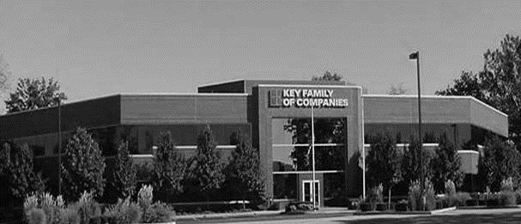



COLLABORATION OF STAKEHOLDERS
Key Benefit Administrators
Employer
Employee
SLUHN’s DTE
Full TPA Administration
Stop-Loss Administration
True Transparency & Analytics
Population Health Management
Utilization & Case Management
Sales & Marketing
Transparent PBM
Website & Mobile App
Customizable options & plans
Incremental Revenues and Margin
Branding & Messaging
Benefit Plan Integration
Network Steerage
Direct Employer/Member Access
Referral Authorization
Plan Transparency
Direct Access to Members
Reduced Spend
“At The Table” with SLUHN
Incentivized Gain Share Potential
Improved Analytics
Lower Stop-Loss
Stabilization
Healthier Population
Reduced Out of Pocket
Improved Health
Better Coordination of Health
Direct Access to the Best Medical Providers

Slide 50
ROLES & RESPONSBILITIES
SERVICES & ADMINISTRATIVE SYSTEMS PROVIDED BY:
SLUHN | KBA Operations
Tier 1 Provider Network Provider Recruitment – If Necessary Network Pricing & Contract Terms Referral Management Protocols & Approvals Medical Director Oversight Practice Improvement Program using KBA/AHDI Data with Assistance from KBA | Network Evaluation – Actuarial Pricing PPO Wrap & Tertiary Transplant Network, if needed Claims Administration Plan Design Development, Testing, and Administration Employer/Member/Provider Customer Service Customized Member/Provider/Agent/HR Portal Billing, Enrollment (Electronic/Paper), and Premium Management Fulfilment – SPD & Customized ID Cards COBRA/HIPAA Administration Out of Network Negotiations Wrap PPO Repricing Nurse Coaching for Chronically Ill Nurse Triage to Physicians and Facilities Stop-Loss Underwriting, Pricing, and Placement Stop Loss Claims Administration Complex Case Management PBM Administration Interface Reporting Utilization & Gaps in Care Clinically Based Physician Profiling Referrals Gain Share Calculations & Distribution Chronic Disease Management Employer Health Risk Management Reports Ancillary Administration – Dental, Vision, Weekly Income, 5500, Life, etc. Health Savings Account (HSA), Flexible Spending (FSA), Health Reimbursement Account (HRA) Administration Sales & Marketing Plan Strategy Development: Branding, Brochures, Web Site Distribution System Development Sales Management
KBA Consulting
Program oversight and integration across the enterprise Goal development, agreement and tracking Start-up assessments: market, network, operational and readiness Draft business plan with financial projections Facilitate program communication and engagement with SLUHN departments including system c-suite, operations, HR, managed care, marketing, strategy and business development

Slide 51

PRE-IMPLEMENTATION
PROVIDER FILE
To Determine Gaps in Medical Service Delivery
PRICING
To Dial in Competitive Stop-Loss Rates and SLUHN’s Net Revenues/Margins
Other Key Providers to Potentially Contract with on Behalf of SLUHN
Wrap Network to Cover All Other Provider Types
Actuarial Evaluation Compared to the Market

Slide 52
IMPLEMENTATION
MONTH 1
Agreement & Project Scope
MONTH 1-6
Implementation
Market Outreach begins in Month 3
MONTH 3-6
Sales & Mkg.
Hire Sales Executive
MONTH 6 TO 8
GO LIVE!!

Slide 53





A Partner You Can Trust
OUR OBJECTIVES ARE ALIGNED
WE KNOW THE
MARKET
COMPLETELY TRANSPARENT
WE HAVE THE SOPHISTICATION AND INFRASTRUCTURE TO EFFECTIVELY COMPETE
Derek Moore, Senior Vice President – KBA
845-283-9973 * derek.moore@keybenefit.com

